Slide 1
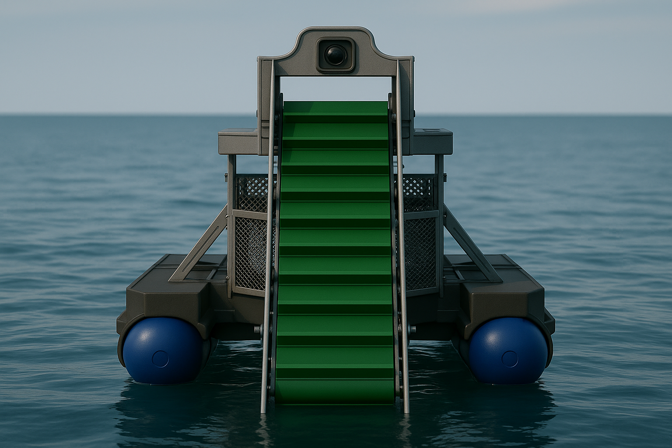
Sall-e – Autonomous Robotic Rubbish Collection System
Group 7.2
Harrison, Max, Leah, Liam, Cham and Hiruni

Slide 2
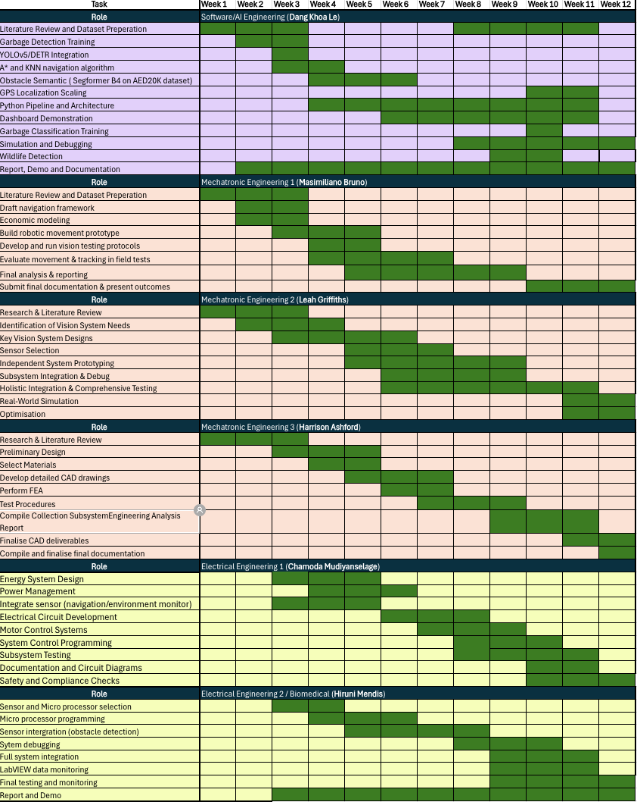
Gantt Chart Project Timeline – Progress Update
Project Status Summary
All deliverables outlined in this demonstration have been successfully completed as scheduled.
Key advancements include the implementation of novel design enhancements, which have demonstrated measurable improvements over baseline performance metrics established during preliminary research.
The project maintained strong adherence to its original timeline, with only minor adjustments required throughout execution.

Slide 3
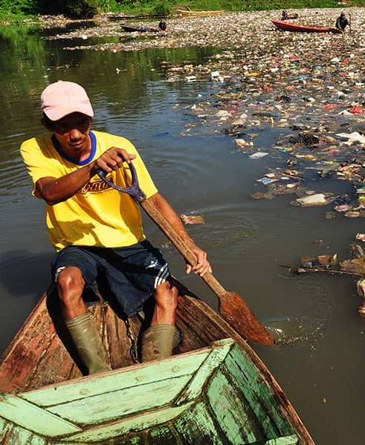
The Problem
Why it matters...
Citarum River: one of the worlds most polluted waterways
40 million people rely on this river – but its filled with plastic, sewage and toxic waste
A global issue: Plastic pollution and waterway degradation are accelerating worldwide
Every year, ~11 million metric tons of plastic enter our oceans from rivers
Consequences of inaction
Human health risks, ecosystem collapse, loss of biodiversity, and long-term water insecurity
Framing the Research Question
“How can we engineer a scalable, autonomous solution to mitigate river pollution in developing regions?”

Slide 4
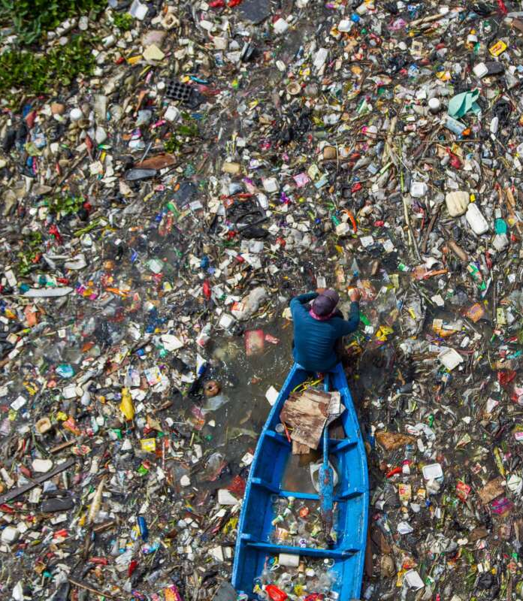
Project Aim & Innovation
Project Aim:
Design and develop an autonomous robotic system for riverine waste collection that is:
Modular in construction
Environmentally responsive
Low-maintenance and scalable
Key Innovation Highlights:
Full autonomy – AI-driven navigation, waste detection, and unloading with no human intervention
Modular netting system – Allows multiple enclosed collection cycles per deployment
Low-cost mechanical integration – Conveyor system prioritised over robotic arms for high-volume throughput
Sustainable energy – Solar-assisted operation extends runtime and reduces emissions

Slide 5
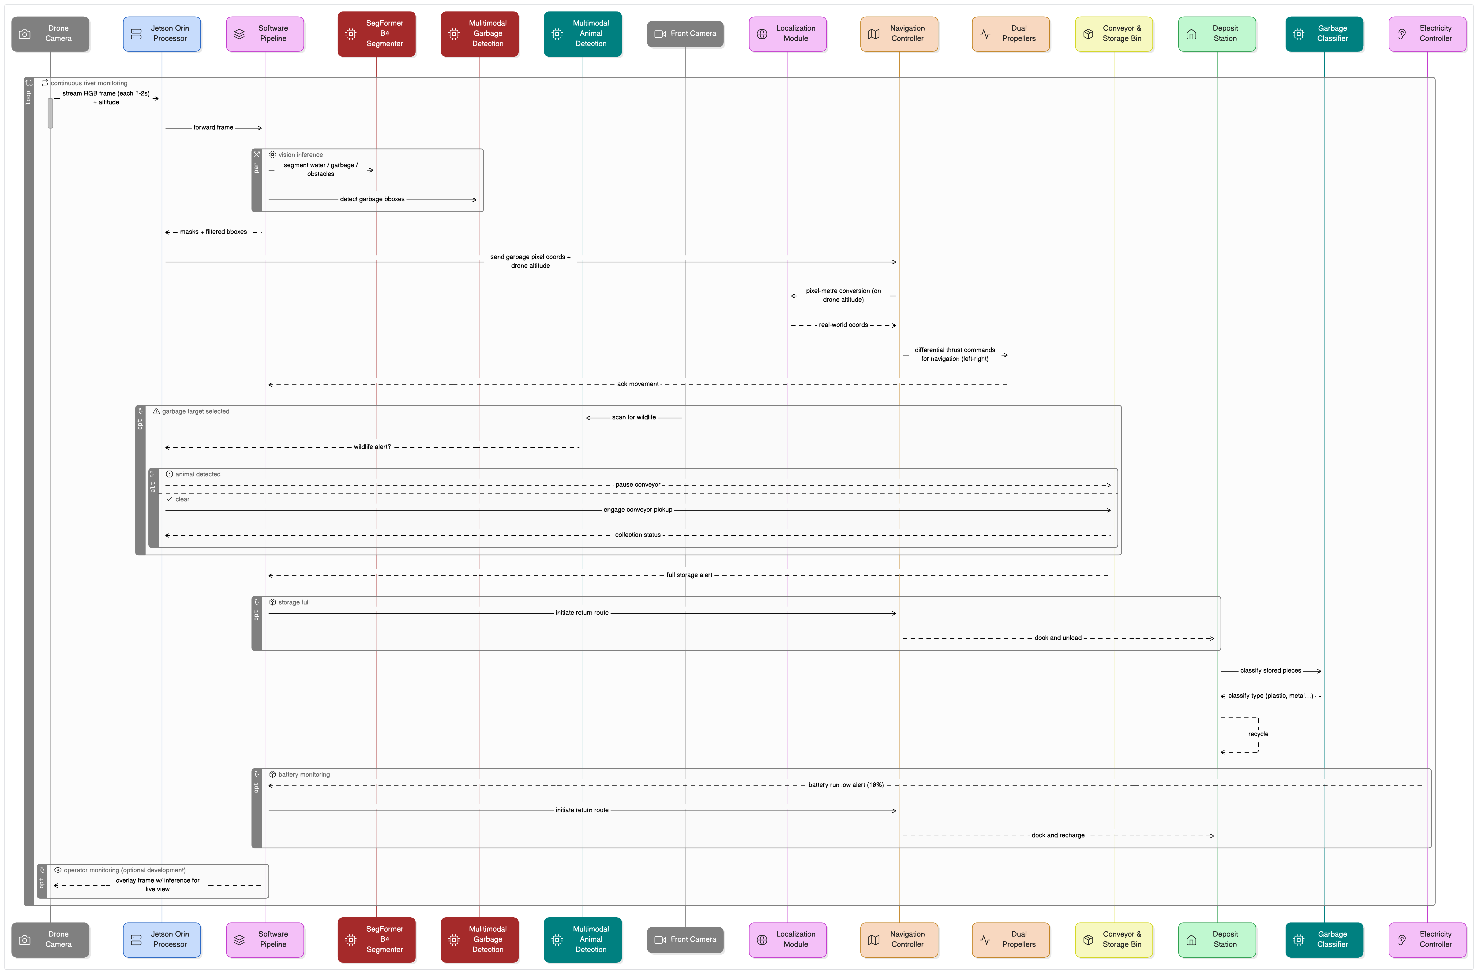
System Architecture

Slide 6
Operation Workflow

Slide 7
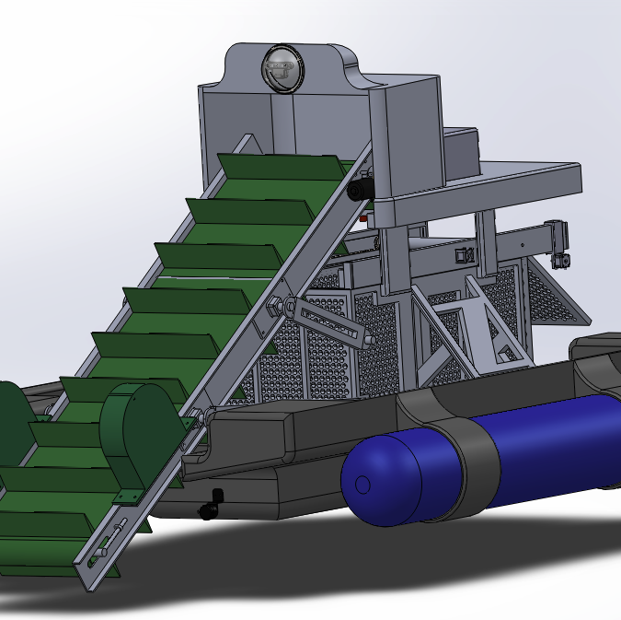
Mechanical Design Overview (Conveyor, Netting, Buoyancy)
Conveyor System
Inclined cleated belt chosen for high-throughput waste retrieval
Throughput ~1.8 kg/min | Motor torque required: 12.5 Nm
Automated Netting Mechanism
4-net cycle; autonomous sensing and release using HDPE mesh
Magnet/clip seal design; retraction powered via pulley-mounted micro motors
Buoyancy and Hull Design
Total system weight = 700 kg
Initial drum-only design insufficient → enclosed hull added
Combined buoyant force = 11,594 N | Safety factor = 1.69

Slide 8
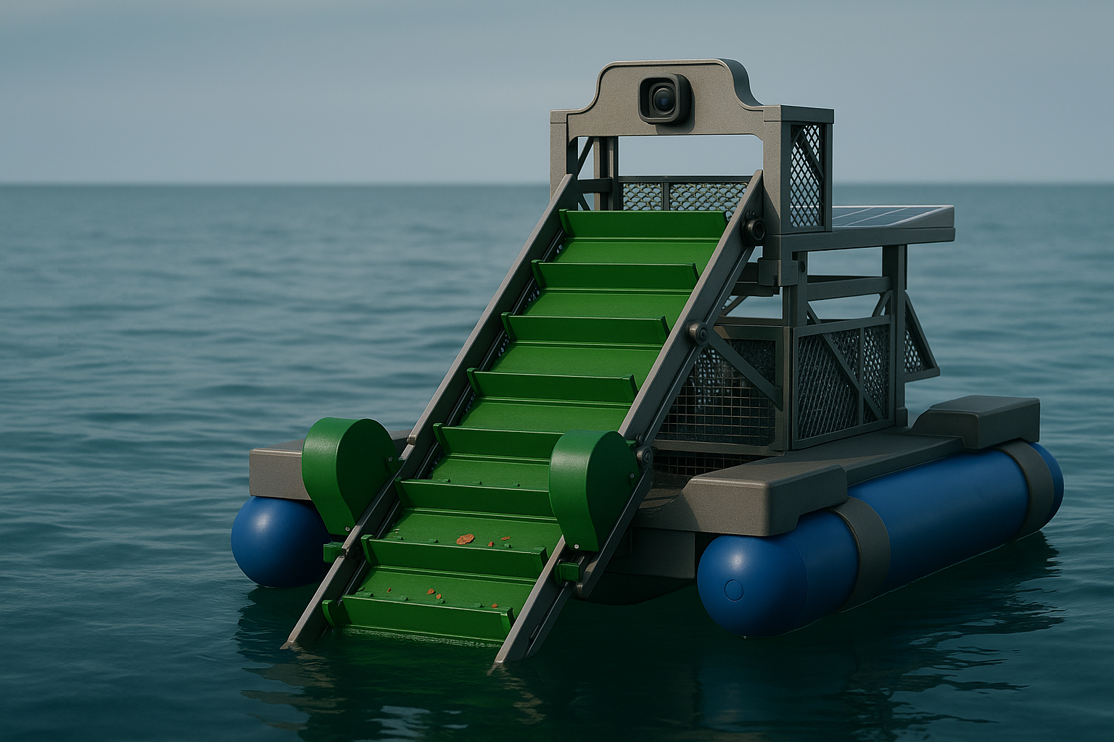
CAD Integration and Structural Validation
Full-system CAD assembly developed using a top-down approach
All six subsystems integrated with defined mounting zones and service access
FEA validated aluminium frame:
Max von Mises stress = 85 MPa | Safety factor ≈ 3.2
Modular frame supports rapid assembly & future subsystem swaps

Slide 9
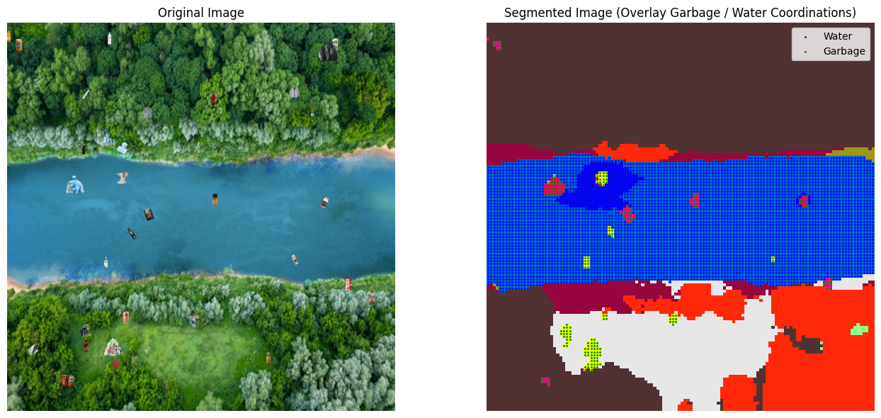
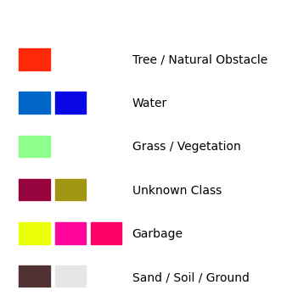
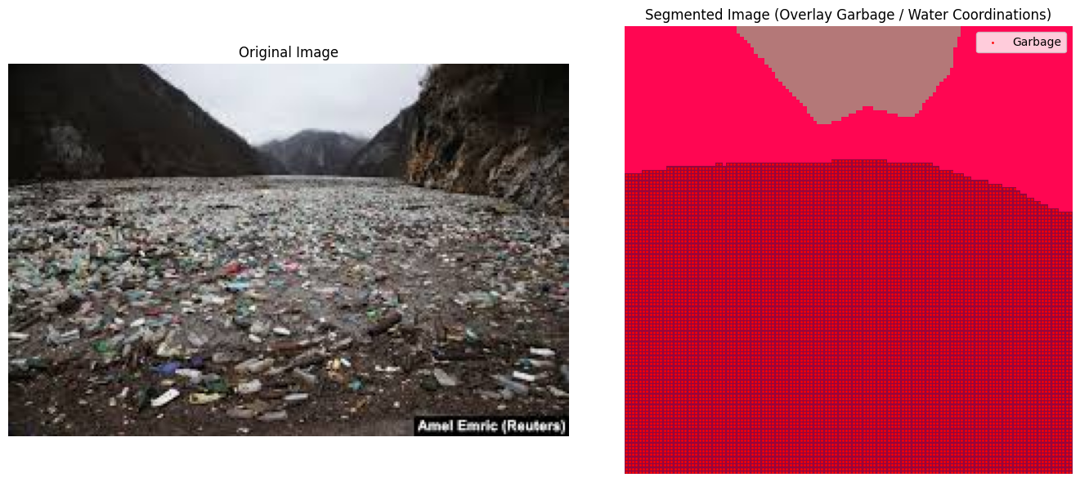
Segmentation
Model: nvidia/segformer-b4-finetuned-ade-512-512
Detects: Water, Garbage, Trees, Sand, Structures

Slide 10
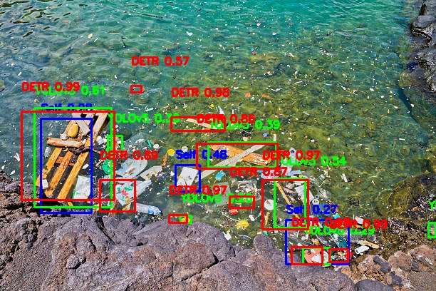
Garbage Detection
YOLOv11l (self-trained)
YOLOv5 (CNN)
DETR (Transformer-based)
YOLO+DETR multimodal system is well-designed architecture (Fahim Rustamy, PhD, 2023)

Slide 11
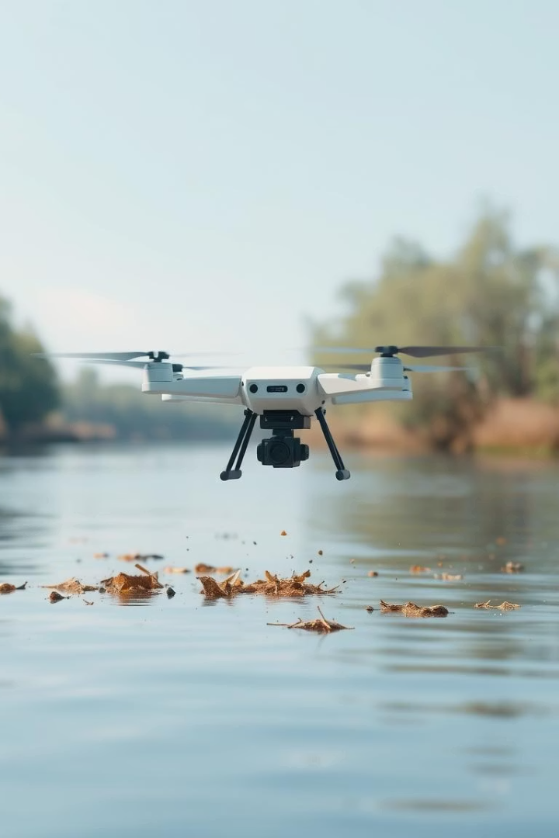
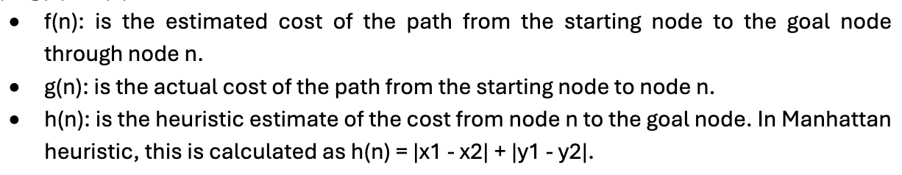
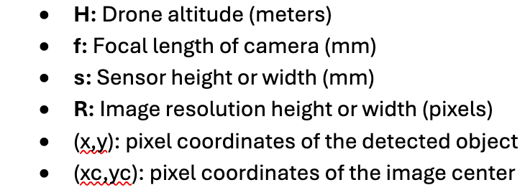
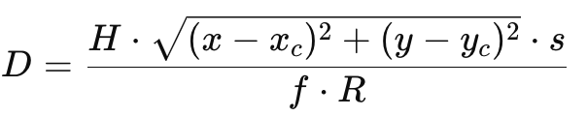
Navigation
Debris Removal
Path Optimization
Debris only flagged as collectable in movable zones
A* + KNN reduces total path by 22% over baseline BFS (Cui et al., 2017)
Navigation Formula
A-star algorithm
f(n) = g(n) + h(n)
Deployment Stage
Apply mathematical program localizing pixel to meter-based coordination
with drone’s altitude.

Slide 12
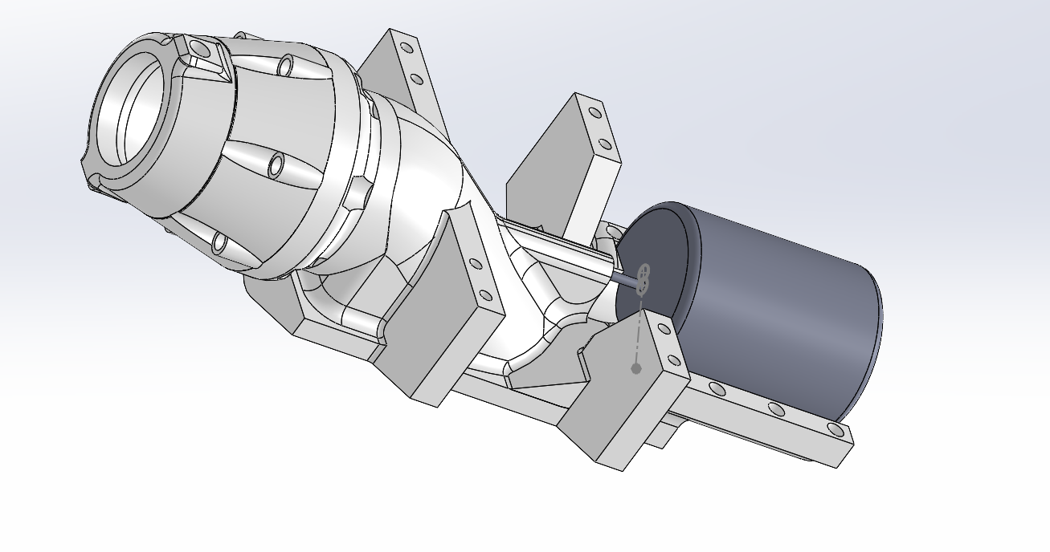

Slide 13
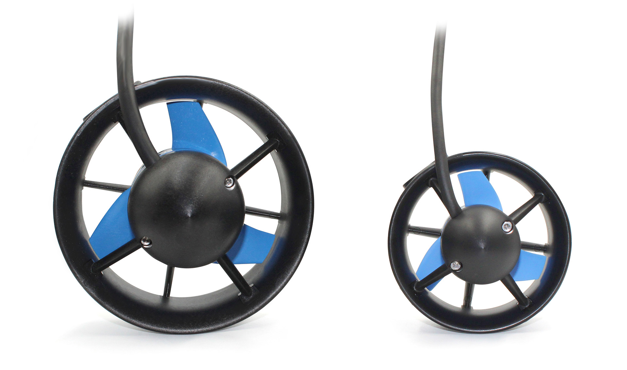
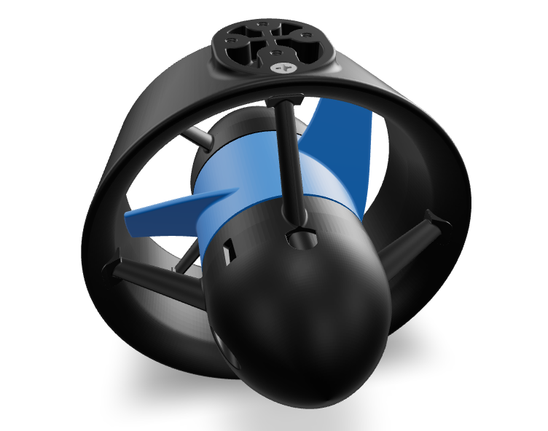
T500 Thruster Unit Installation and Performance
Thruster Type: 2 × Blue Robotics T500
Location: Mounted beneath rear pontoons
Housing: Integrated in streamlined cylindrical casings for protection from debris and shallow water damage
Power Input: 24V DC @ 43.5A max each (up to 1 kW per motor)
Controller: Basic ESC 500 (bidirectional, 1 per motor)
Dimensions:
Length: 130 mm
Diameter: 100 mm
Cable Length: 1.5 m
Performance:
Max Thrust: 157.9 N per motor
Combined thrust: 315N
Speed: 1.2 m/s (empty, 288 kg) → 0.5 m/s (full load, 550 kg)

Slide 14
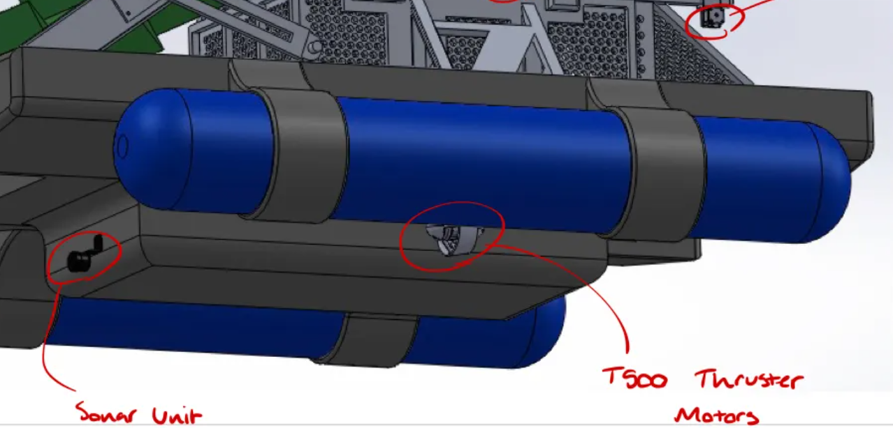

Slide 15
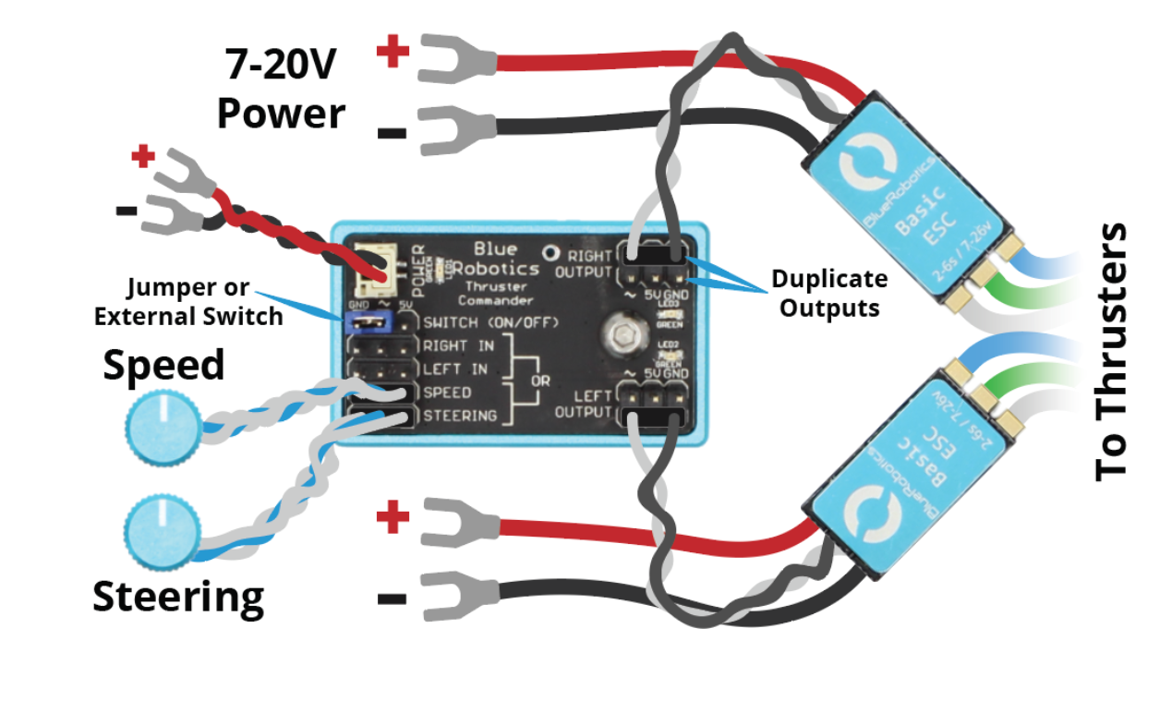
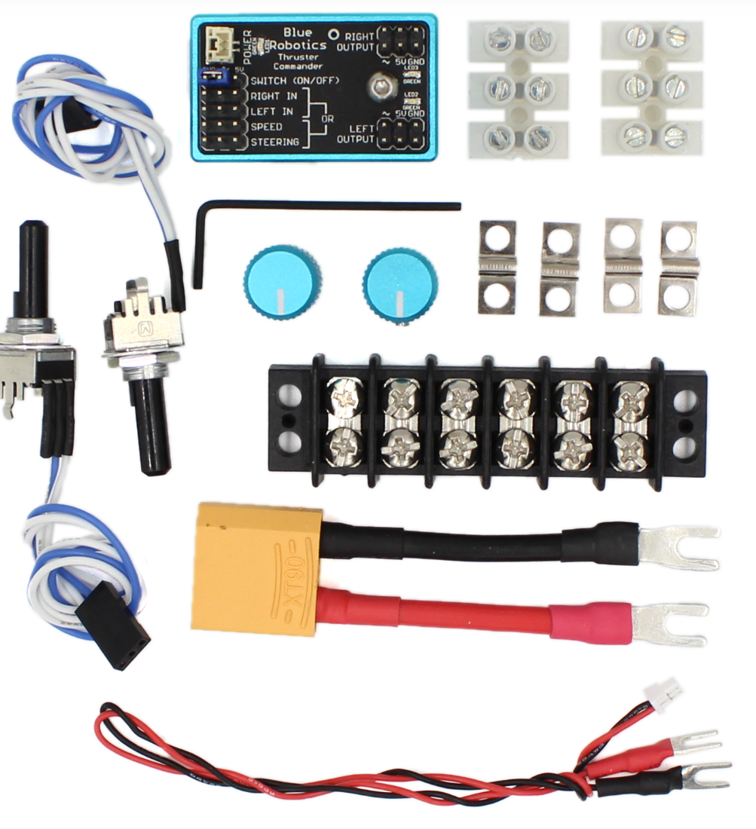
Thruster Control System – Thruster Commander
Control Mechanism:
Receives input from onboard software & sensors.
Converts navigation data into differential speed signals for each motor
Outputs to Basic ESC 500 controllers T500 Thrusters
System Functions:
Mixed speed/steering mode for dynamic direction control
Power input: 7–20V
Output: 2 channels (dual motor compatibility)
Integration Notes:
Mounted in sealed, waterproof housing onboard
Interfaces cleanly with microcontrollers and vision systems

Slide 16
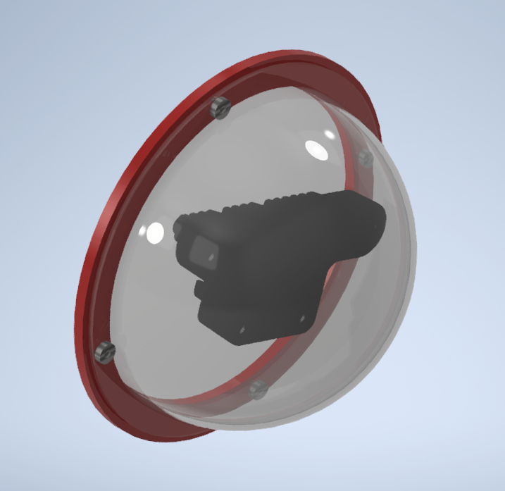
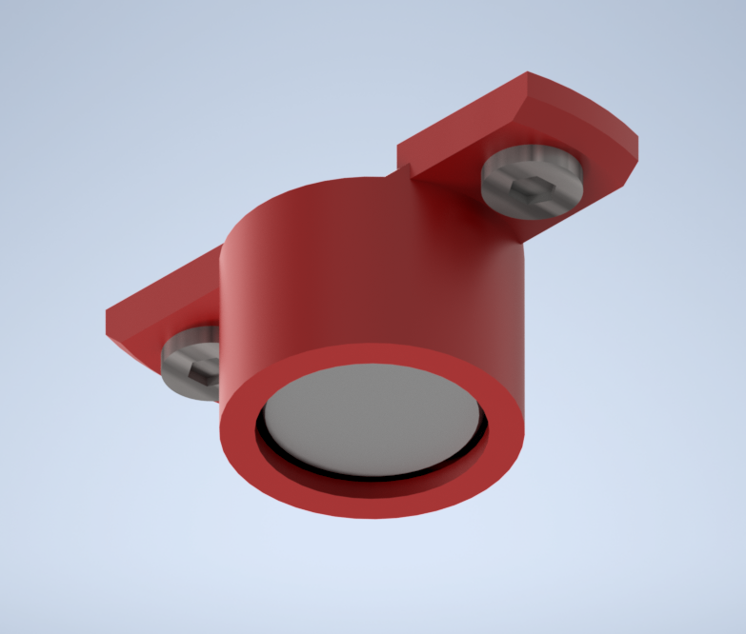
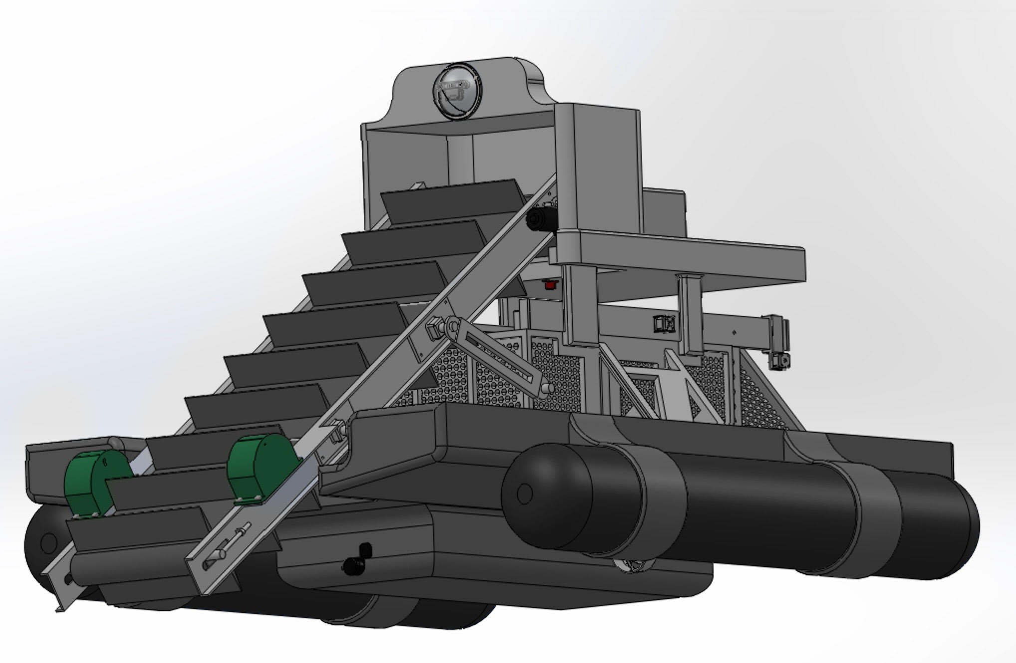
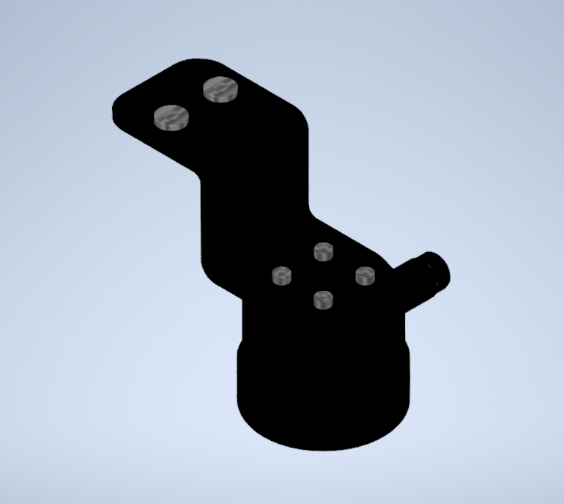
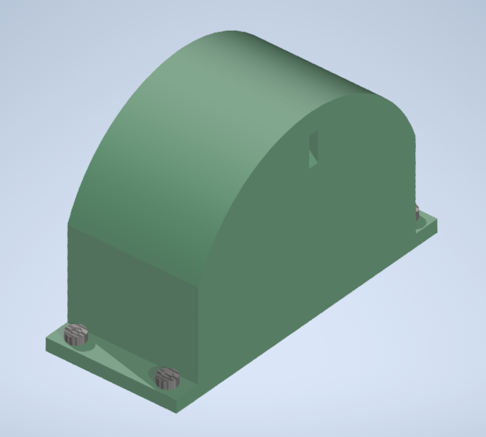
Sensor & Vision Systems
Notes:
I used four sensors across the design:
An ultrasonic sensor sitting above the collection bin to monitor waste level
A pair of time-of-flight sensors across the conveyor belt to detect overload
An OAK-D camera inside a waterproof dome for wildlife detection
And a sonar unit submerged to navigate underwater debris

Slide 17
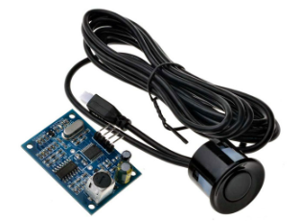
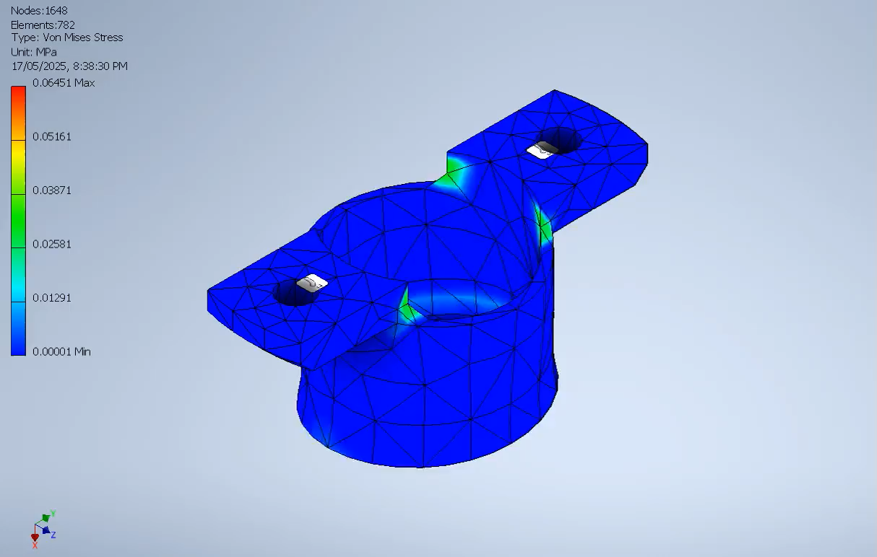
Ultrasonic Sensor: Bin fill detection
JSN-SR04T
Sensor mass : 25 grams
Waterproof (IP66 rated)
Range: 20cm - 6m
Designed custom mounting bracket
Material: PETG (flexible and printable)
FEA of mounting bracket:
Load case: 0.25N (25g) x 5 outdoor safety factor
FEA Results:
Displacement: 0.0007mm
Von Mises: 0.06 MPa (PETG yield strength = 45-55 MPa)
Notes:
For bin collection I chose the JSN-SR04T waterproof ultrasonic sensor, mounted above in a custom PETG bracket. For simulation, I applied a 0.25N with a safety factor of 5 for outdoor impacts. Result shows negligible displacement and stress – well within limits.

Slide 18
Retrieval Trigger Mechanism

Slide 19
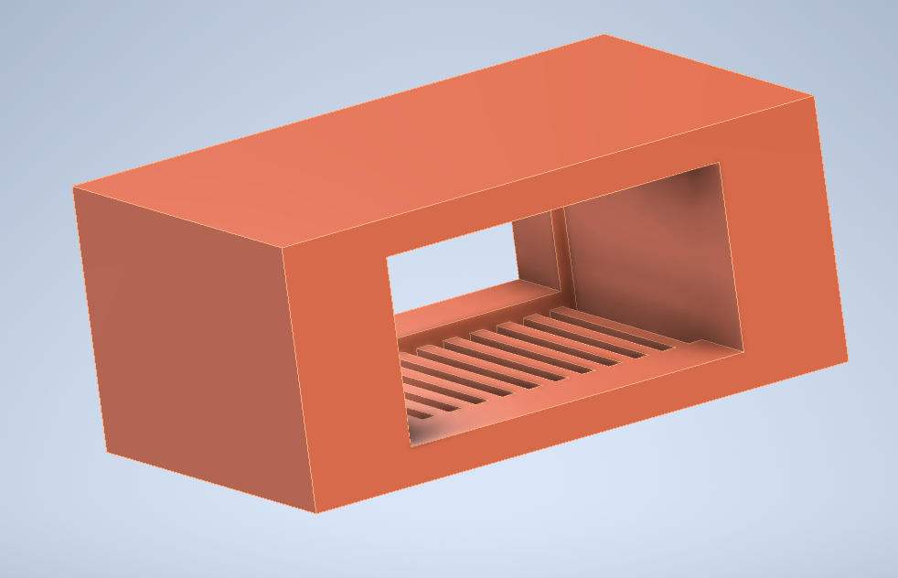
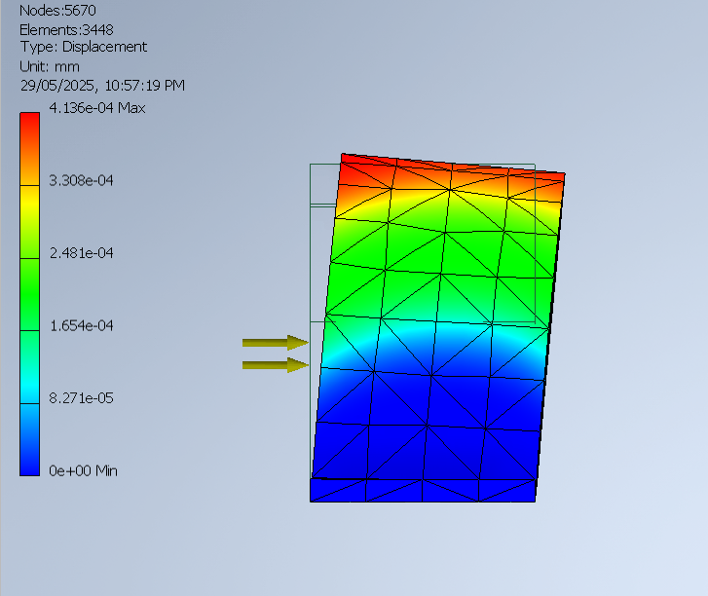
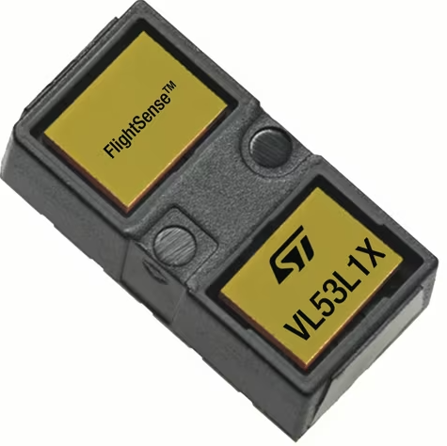
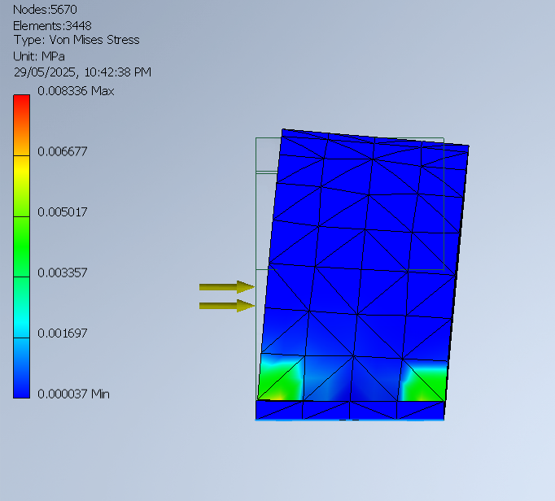
Time-of-Flight Sensor: Conveyor Overload
VL53L1X
Sensor mass : 3.8g
Range: 4m
Designed custom mounting bracket
Material: PETG (flexible and printable)
Added waterproofing and drainage features
FEA of mounting bracket:
Load case: 60.5N for max storm winds observed in area
Safety factor: 1.5 for storm gusts
FEA Results:
Displacement: 0.0004mm
Von Mises: 0.008 MPa (PETG yield strength = 45-55 MPa)
Notes:
For conveyor overload I chose a pair of VL53L1X time-of-flight sensors mounted across the conveyor. Again, I modelled a PETG mounting bracket and applied a 60.5N wind load for typhoon ratings, scaled by 1.5 for storm gusts. FEA results showed negligible displacement and stress – well within safe limits.

Slide 20
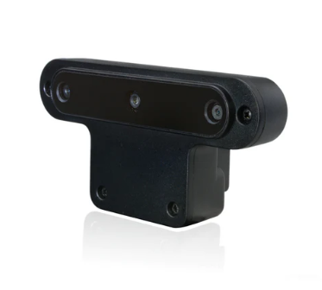
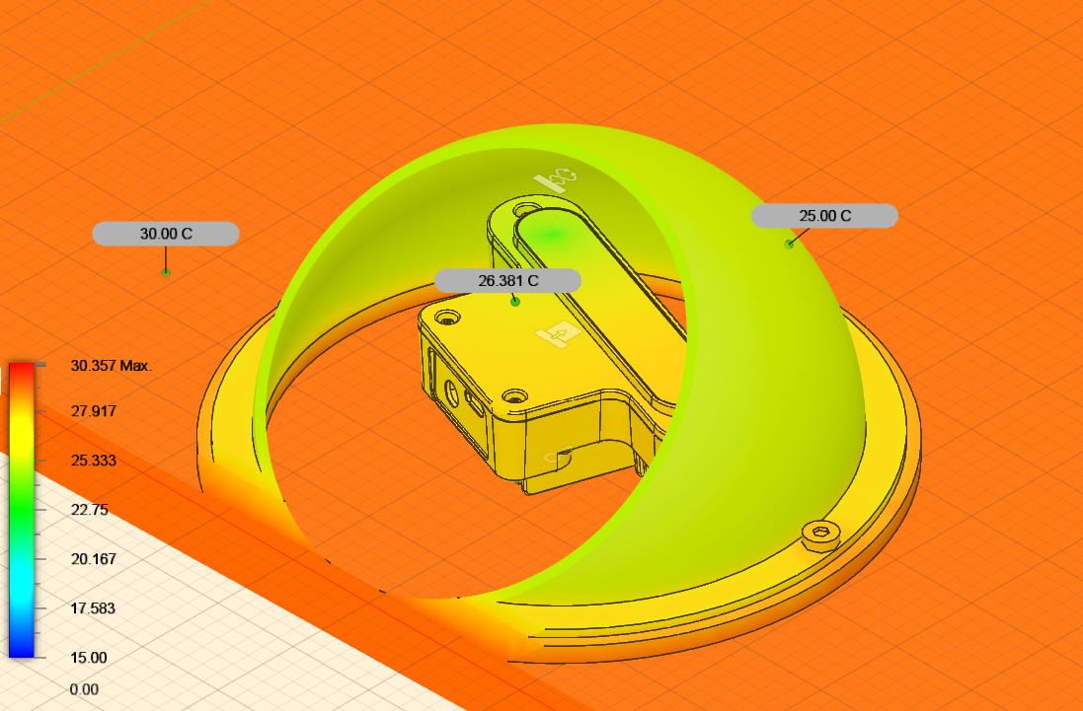
OAK-D Camera: Wildlife Detection
OAK-D by Luxonis
Depth sensing and onboard AI
Power consumption: 4 Watts
Mounted to front of assembly
Used with CCTV dome for water protection:
Material: Polycarbonate (clear), Rubber silicone for seal
Thermal stress analysis inputs:
4 Watts internal heat from camera components
5 Watts, 35-degree Celsius convection from ambient air
Thermal Stress Results:
Max internal temp only 1-degree above applied temp
Notes:
I chose to use an OAK-D camera for overall vision with a polycarbonate dome usually used in the case of CCTV for waterproofing with a silicone seal. I applied 4 watts of internal heat and thermal outputs from ambient air. The results show the temperature peaked at 1 degree above the applied temp – within safe working conditions for the camera.

Slide 21
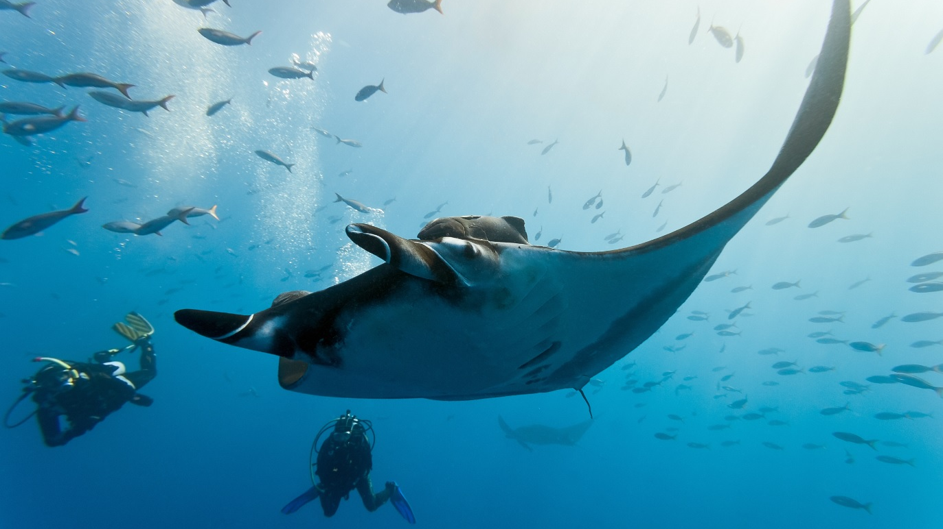
Protecting Indonesia's Riverine Ecosystem
The Citarum River's Rich Ecosystem: Despite its pollution challenges, the Citarum River basin supports a diverse array of wildlife, from over 20 fish species to more than 300 bird species, amphibians, reptiles, and mammals

Slide 22
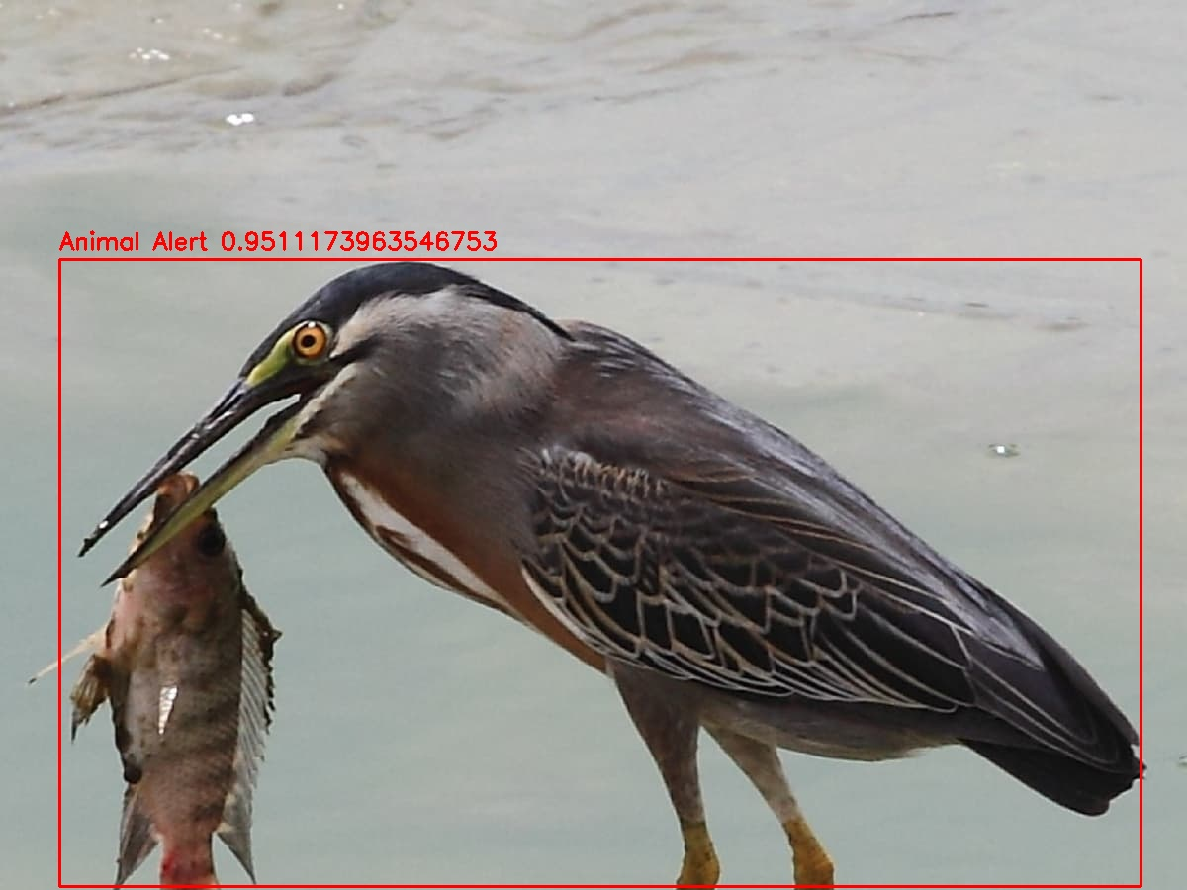
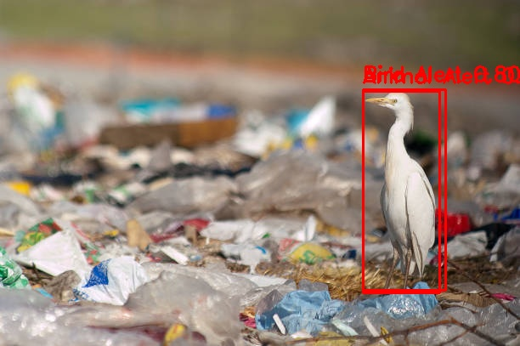
Wildlife Detection
Model Stack:
YOLOv8n → mammals and birds (80+ COCO classes)
Fish model → small fish in garbage areas
Bird model → birds perched on floating debris
Control Behaviour:
Frames with any valid detection halt conveyor pickup
Resume only when clear — updated each frame
YOLOv8n chosen for its low-latency inference (<20 ms/frame) and edge compatibility.

Slide 23
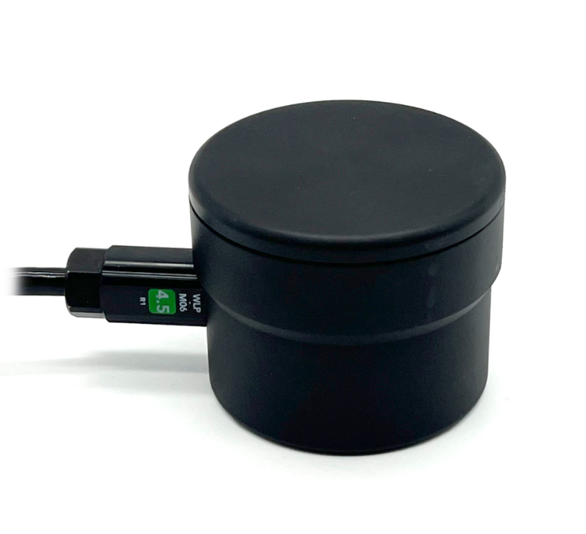
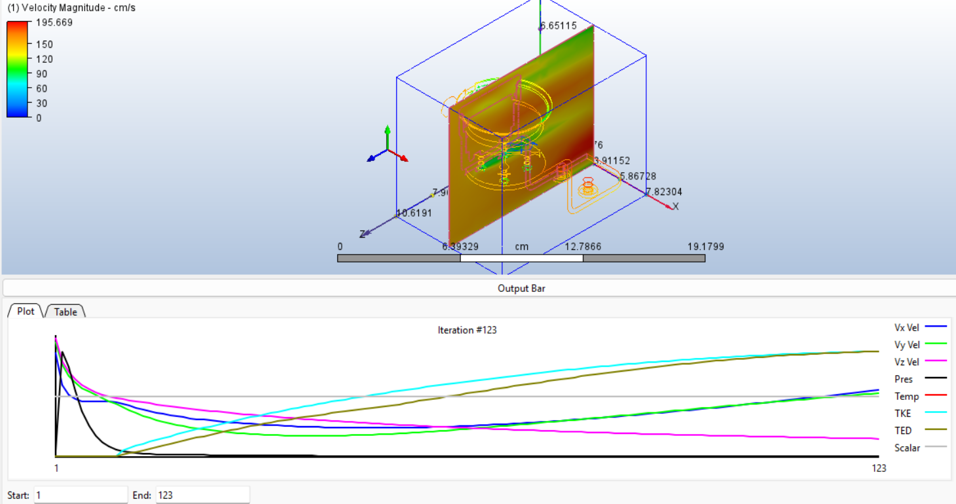
Sonar Sensor: Underwater Detection
Blue Robotics Ping Sonar Altimeter and Echosounder
Submergible waterproof sensor
Range: 0.5 - 30 m
Beam angle: 30 degrees
CFD Simulation:
Water speed: 1.5 m/s - modelled from observed storm water speeds in area
CFD Hydrodynamic Flow Results:
Smooth, laminar flow
Negligible turbulence over sensor
Total force: < 1N
Flow does not interfere with sonar performance
Notes:
The sonar unit is mounted at the bottom of the system using the provided zinc bracket. simulated a 1.5m/s waterflow to test the hydrodynamic flow. Results showed no turbulence forming around the sensor and forces on the bracket stayed under 1N.

Slide 24
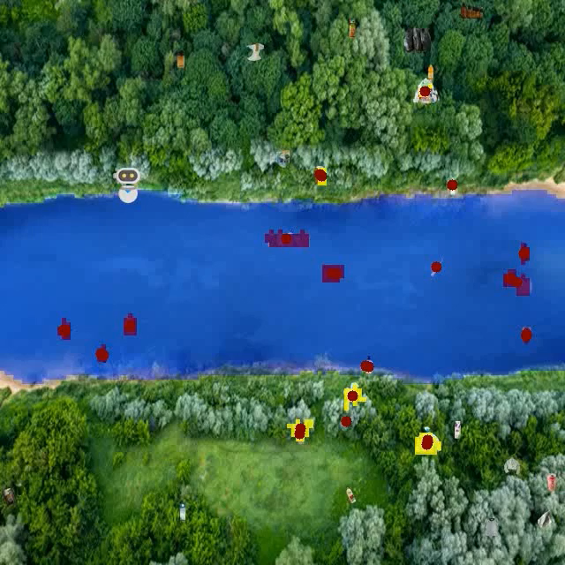
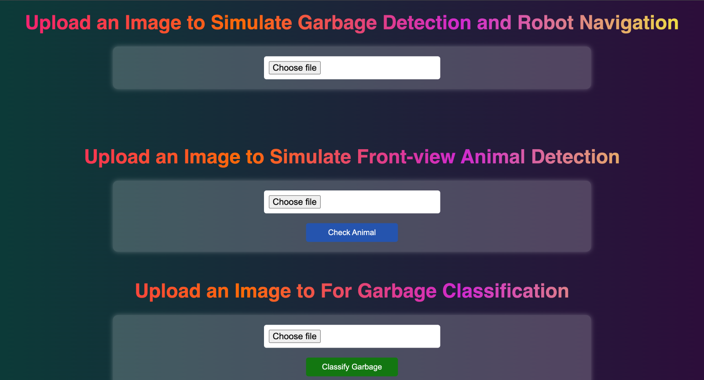
Runtime Performance
Hardware:
Jetson Orin 64 GB (35W TDP)
Drone video streaming service
Metrics:
Segmentation: ~40 ms
Detection: ~35 ms
Total processing: < 100 ms per frame
Simulation​
Simulating full software pipelines on web-inference.​
10 FPS video streaming (H.264)
Access Web Simulation at:
https://binkhoale1812-sall-egarbagedetection.hf.space/ui

Slide 25
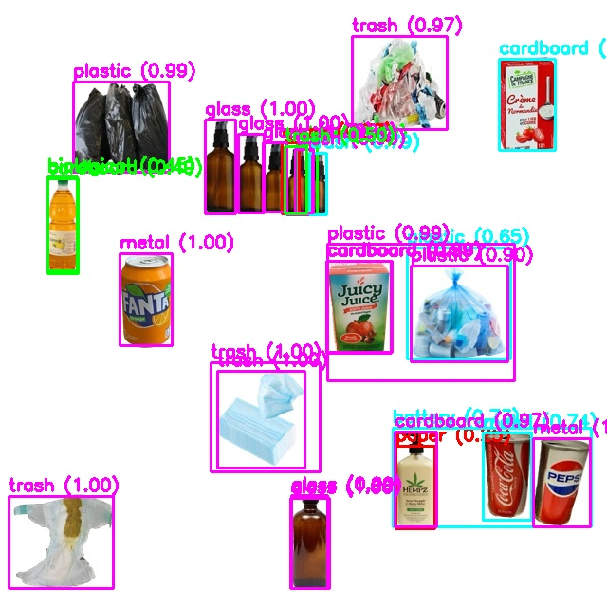
Recycle Classifier
Post-collection, we leverage a YOLOv8s classifier (custom trained on 10 distinct garbage categories) to enable precise waste segregation, driving efficient recycling and greener downstream processing.
Key Implementation:
Model Stack: Custom-trained YOLOv8s waste classification.
Outcome: Model return with 97% accuracy on test-set while stay minimizing with 3-4% loss.
Impact: Critical for automating recycling workflows and reducing environmental harm.

Slide 26

🔋 Objective:
Designed a 24V modular power system to support full robot autonomy
Powers propulsion, conveyor, AI computing, and sensors for 4+ hours
Modular Power Architecture for Autonomous Operation
☀️ Solar Charging:
3 × 350W monocrystalline panels (1050W total)
MPPT controller (24V, 40A) for optimized charging
Fully recharges in ~5 peak sun hours
🔋 Battery:
24V 150Ah LiFePO₄ (3600Wh usable)
Long cycle life, thermally stable, ideal for field use
Key Benefits:
✅ Fully off-grid, daily recharge ready
✅ Modular, scalable, and low-maintenance
✅ Essential for real-world autonomous operation
Battery Recharge:
Trigger a system alertwhen battery drops below5%
Perform battery replacement at thedocking station tominimize downtime andmaintain operationalefficiency.

Slide 27
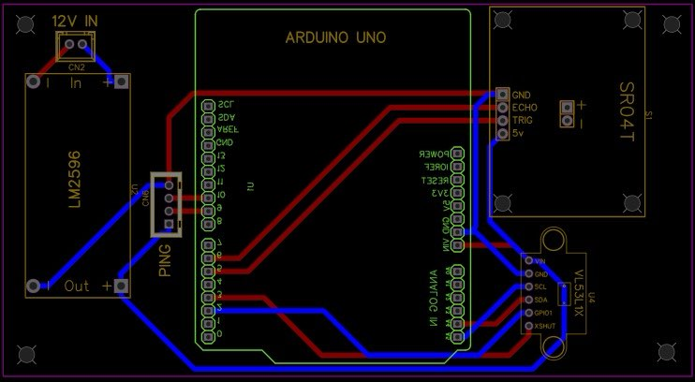
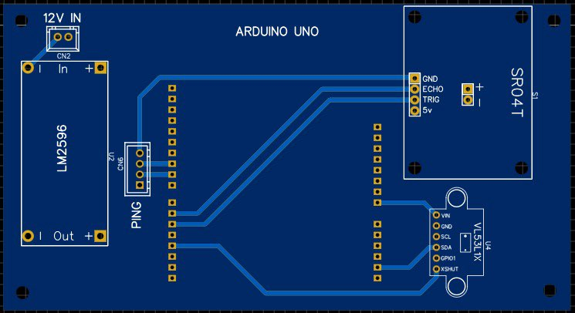
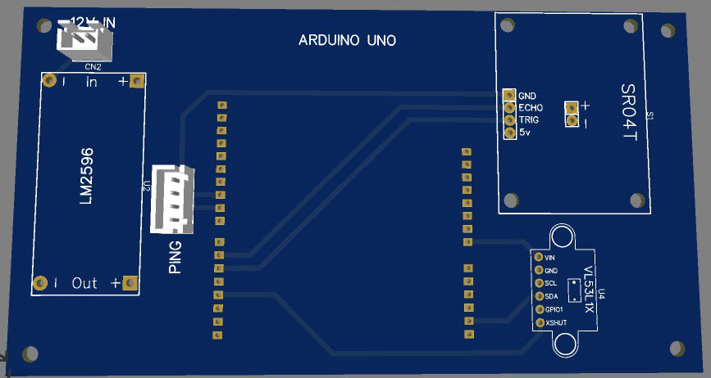
Custom PCB Design & Sensor Integration

Slide 28
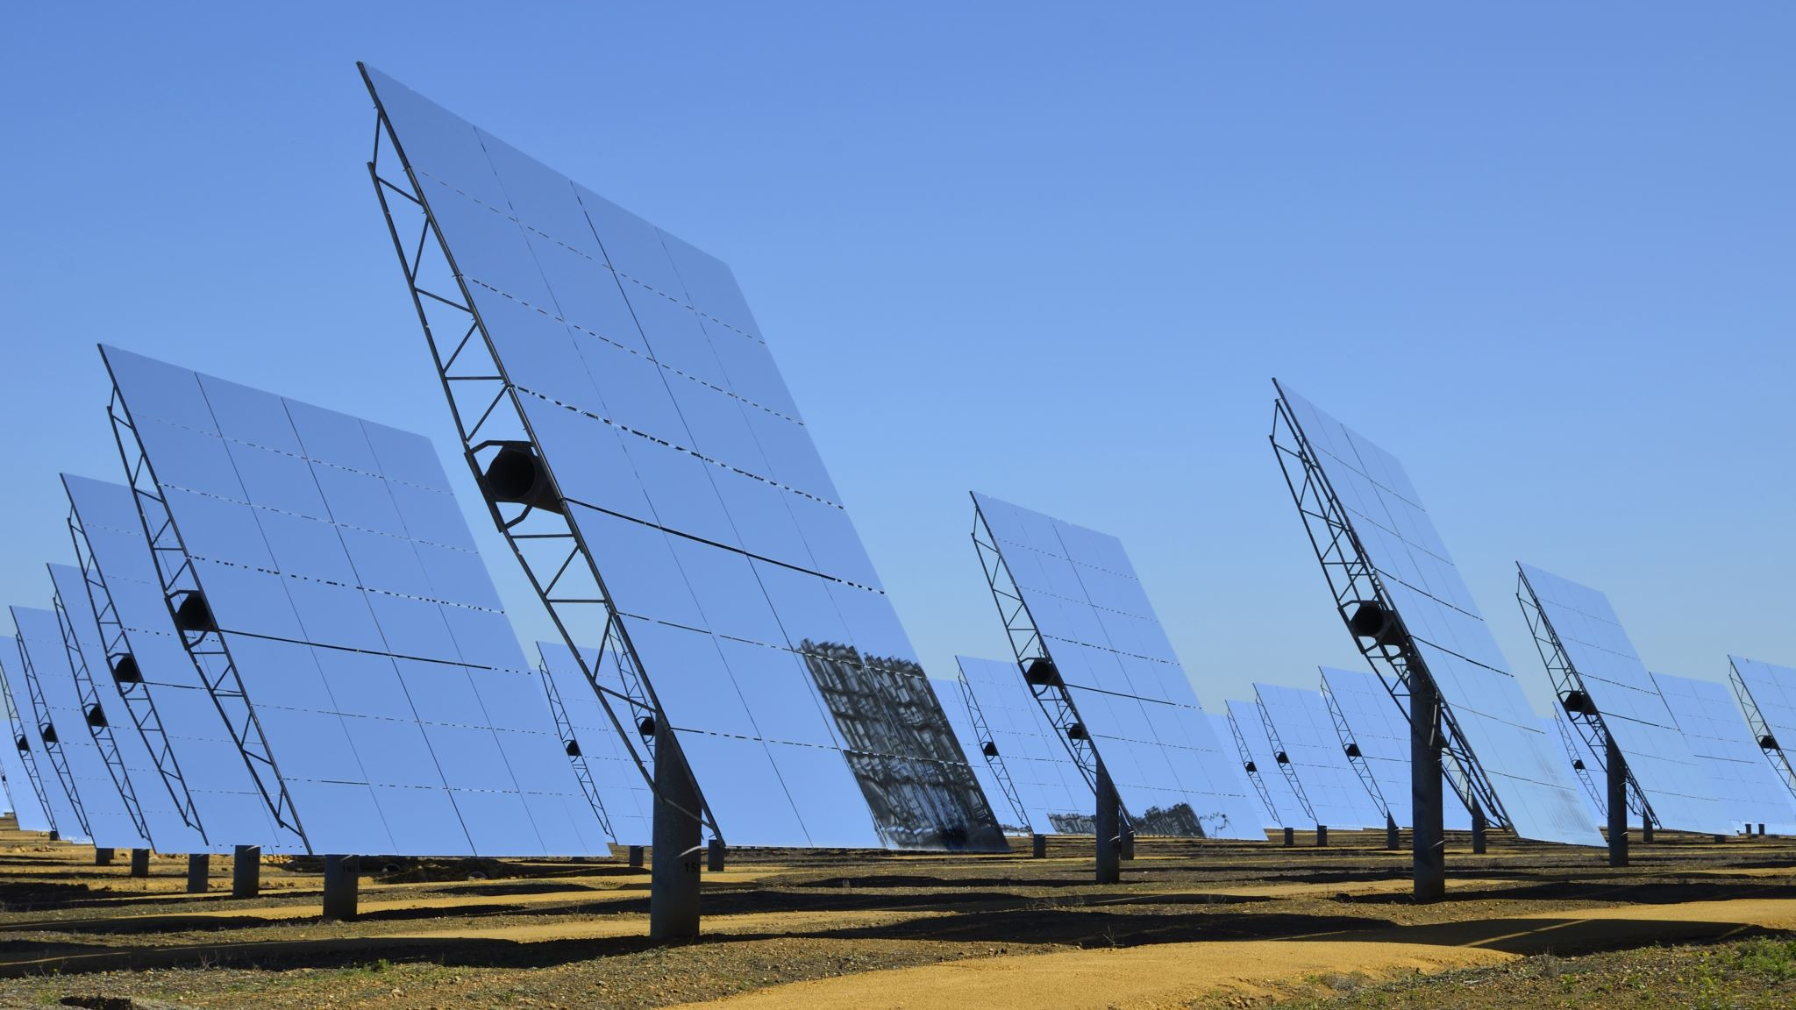
System Results & Electrical Contribution
🎯 Performance Results:
System powered 4+ hours on a single charge (686W average load)
Solar panels (3 × 350W) fully recharged battery in ~5 peak sun hours
Sensors ran with stable 5V output, <50mV voltage ripple
Jetson Orin operated continuously at ~60W load during AI inference
🧪 Testing Outcomes:
PCB tested under full load – all sensors produced accurate, consistent readings
No thermal drift or signal loss across sensor suite
Arduino + Jetson Orin communication via I²C and UART validated
🧩 System Contribution:
Forms the core power and control backbone of the robot
Enables autonomous decision-making without external power or connectivity
Modular PCB design simplifies upgrades and maintenance
Solar-charging integration supports daily off-grid deployment
🌍 Why It Matters:
“The electrical system ensures that Sall-e is not only autonomous, but energy-resilient, safe, and ready for real-world use in polluted river environments.”

Slide 29
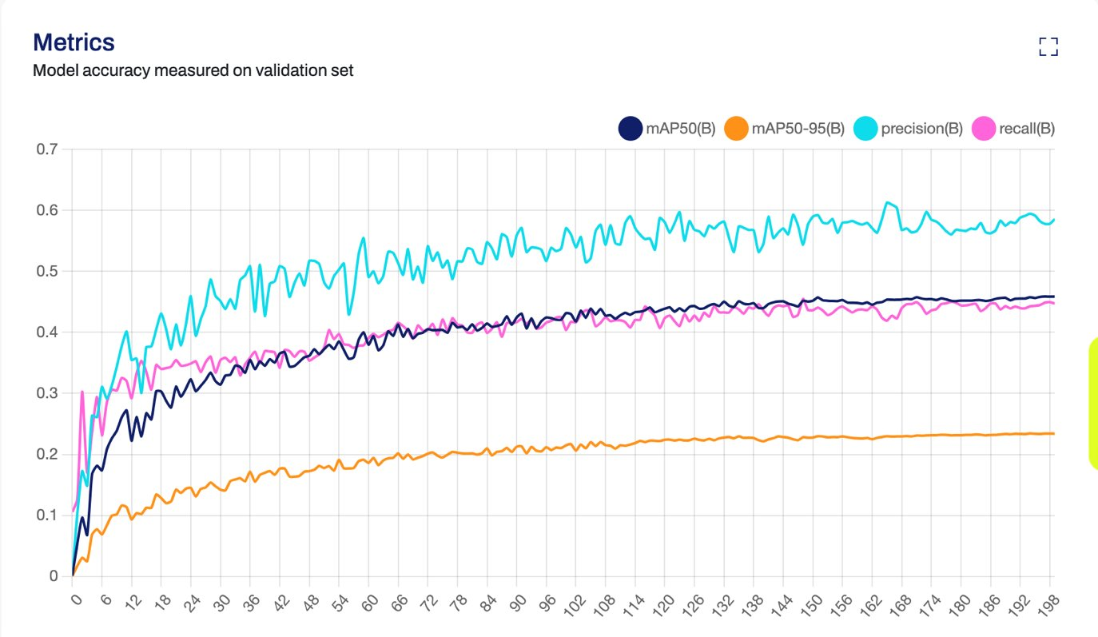
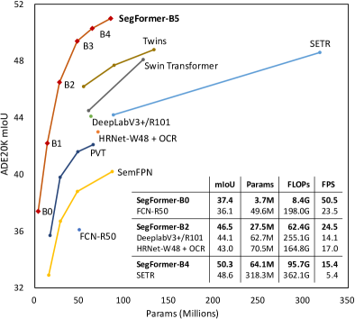
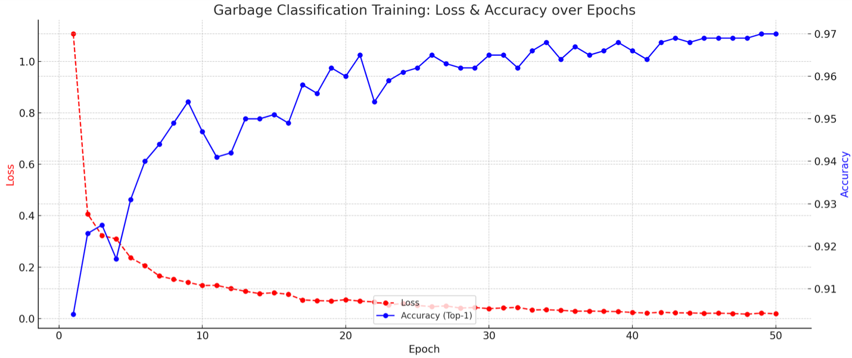
Software Deliverables
SegFormer-B4 achieves 50.3% mIoU (max 84.0%) on ADE20K only with 64M parameters, proving performance under terrain variation (NVIDIA 2021).
Under complex environment, custom-trained reaches 60% percision with stabilized mAP indicate low false positive and overfitting.
Multimodal detection architecture reutns 91–93% accuracy on test-sets.
Garbage Classification
~92% across10 distinct garbage categories.
Maximum accuracy reaching 97%.
Navigation Success
96% average successful collection rate across 10 simulation tests

Slide 30
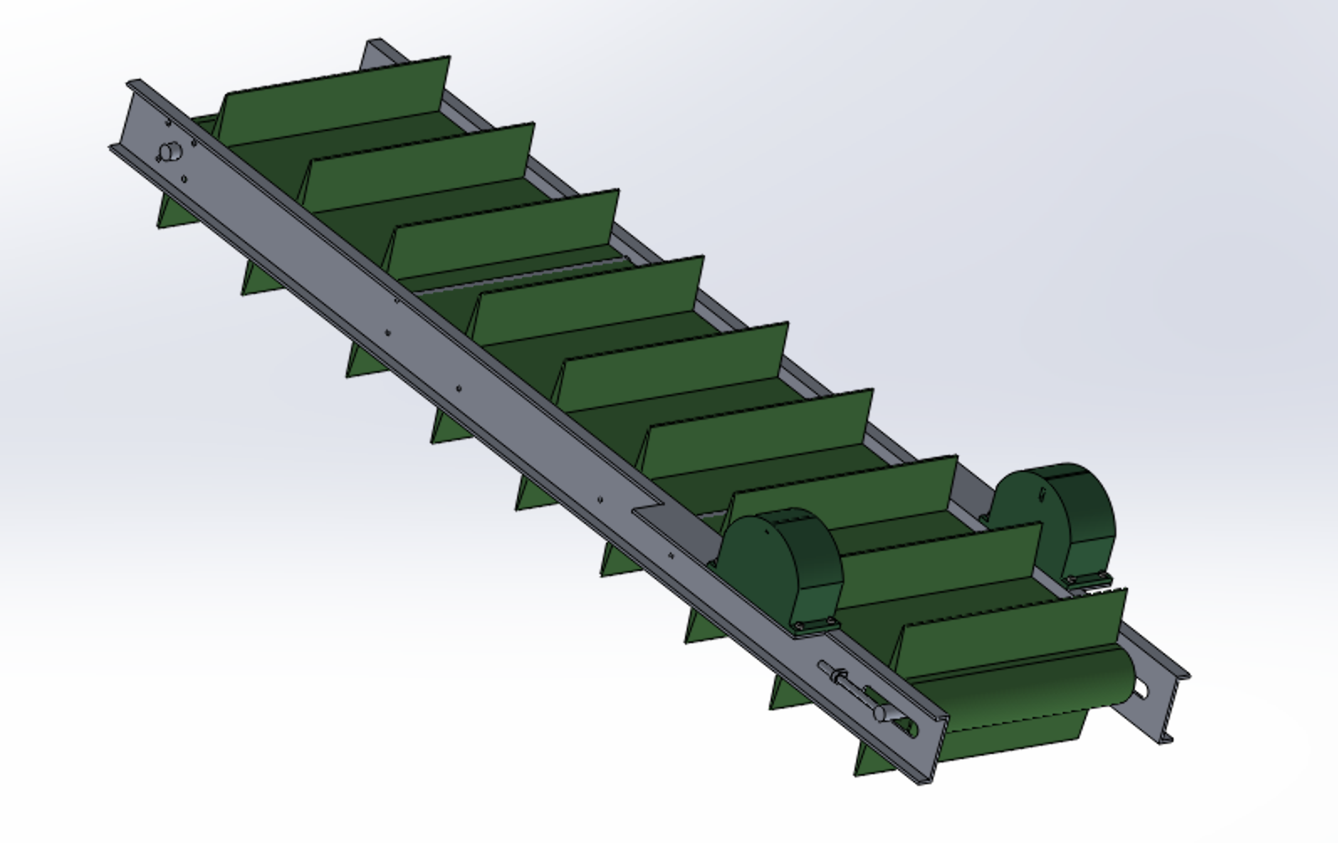



System Integration
System Hardware
Final Integrated System
Electrical Components
Waste Collection Subsystem
Flotation / Support Subsystem
Software
=
Sensors
Frame & Waste Dispense Subsystem

Slide 31
Life Cycle
Subsystem | Component(s) | Lifespan / Maintenance | Notes
Robotics | Conveyor Belt, Cleats, Drive Motors | Inspect every 3 months; replace belt annually | Exposed to debris, wear-prone; HDPE netting replaced with wear or damage
 | Buoyancy Hull + Seals | Inspect bi-annually; replace seals if brittle/damaged | PETG & HDPE assumed; exposure to UV and water stress
 | HDPE Netting System | Every 4–6 collection cycles (or as torn) | Based on 4-net design; autonomously swapped during operation
 | Structural Frame (Aluminium) | 3–5 years before fatigue inspection | Modular, FEA validated; inspect if mechanical shock or overload occurs
Propulsion | T500 Thruster Motors | 500–1000 hours of operation | Rated for underwater continuous use; inspect impellers quarterly
 | Thruster Commander + ESC | Replace/inspect every 2–3 years | Sealed; heat-safe; ensure no signal dropout or moisture exposure
Electrical | 24V LiFePO₄ Battery (150Ah) | >2000 cycles (~3 years daily charge) | Thermally stable, solar-recharged; cycle lifespan based on LiFePO₄ chemistry
 | Solar Panels (3×350W Mono) | 20–25 years (standard panel lifespan) | Minimal maintenance; clean every 6–12 months for dust/water clarity
 | Custom PCB + Power Regulation | Inspect annually; replace every 4–5 years | Modular design simplifies hot-swap if failures occur
Sensors | Ultrasonic Sensor (JSN-SR04T) | Replace every 2 years or on damage | Waterproof (IP66); failure rate rises in high humidity after 2 years
 | ToF Sensor (VL53L1X) | Replace every 3–4 years | Low thermal drift; PETG bracket tested for storm conditions
 | OAK-D Camera | 3–4 years (subject to humidity and dirt) | Polycarbonate housing protects from water; thermal stress rated to <1°C drift
 | Sonar Sensor (Ping Altimeter & Echosounder) | 3 years, check quarterly for marine fouling | Submersible; resistant to turbulence per CFD simulation
Software | Automation pipelines and modelling | Update every 6 months with model retraining | Ensure compatibility with updated datasets and environmental conditions
 | Web Dashboard + Data Logging | Patch monthly; audit logs quarterly | Telemetry logging, for system debugging and controls.
 | Jetson Orin unit (GPU) | Maintain every 6 months; | Ensure compliance with updated software and reliable runtime operation.

Slide 32

Real-world Impact
Operational Safety and Efficiency
Socio-Economic Upliftment
Enviromental Restoration

Slide 33


Economic Feasibility & Broader Impact
Total Estimated System Cost: $10,000 - $15,000
Opportunity Cost Analysis:
Low-cost, sustainable solution
Replaces fuel-powered collection boats and labour hours
Local Benefits to Circium River:
Cleaner waterways, revived aquatic ecosystems
Better habitats, boost to fish populations and biodiversity
Opens river for eco-tourism, kayaking, and river transport
Return on Environmental Investment (REI):
Long-term reduction in waterborne waste = lower maintenance costs for local councils
Improved public health, aesthetics, and community well-being
Foundation for future smart waste monitoring or expansion (drones, automation)

Slide 34

Ethical AI Integration - IEEE7000 Standard
Value Based Engineering (VbE)
- Safety
- Transparency
- Equity
Ethical Risk mitigation
- Wildlife detection
Accountability
- Ethical logs to be shared with Indonesian national conservation agency (BKSDA)

Slide 35

Legal Compliance
Evolving AI Regulations
Data Protection
Enviromental compliance and integration

Slide 36

Future Scope & Recommendations
Field Trials
Validate performance in live conditions on the Citarum River - focus on net deployment reliability, AI object detection accuracy (>85%), and power endurance
Real-time Analytics
Add telemetry: track rubbish types, collection rates, battery health, and system diagnostics for adaptive decision-making
Modular Upgrades
Enable subsystem swapping (e.g. alternate net types, upgraded sensors, or AI models) to tailor deployment to specific river conditions
Swarm Deployment Potential
Network multiple units via low-latency communication to cover larger areas, reduce downtime, and increase system redundancy

Slide 37

Conclusion
Reaffirm the challenge
Plastic and organic pollution in rivers like the Citarum poses escalating global threats
Highlight our engineering response
Sall-e: autonomous, modular, and sustainable—built through interdisciplinary design
Why Sall-e is a viable solution
Technically validated, economically scalable, and ready for real-world deployment

Slide 38

Questions & Answers
We are welcome for question, in regards to the design and development of Sall-e

